Slide 1
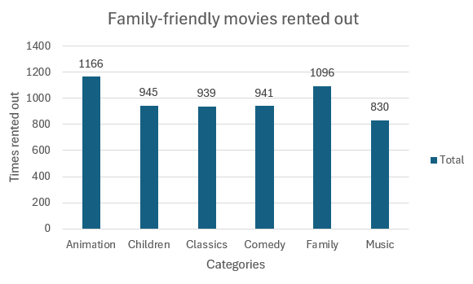
1. How many times have the family-friendly movies been rented out?
Animation is the most popular movie category, followed by Family category

Slide 2
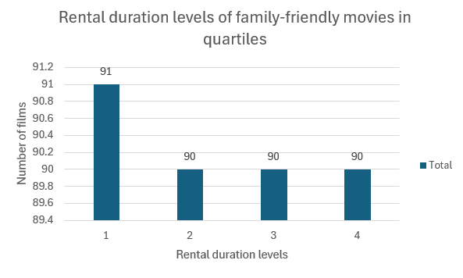
2. Rental duration level of the family-friendly movies compare to all movies rented out in quartiles?
All 4 rental duration levels have approximately the same number of films

Slide 3
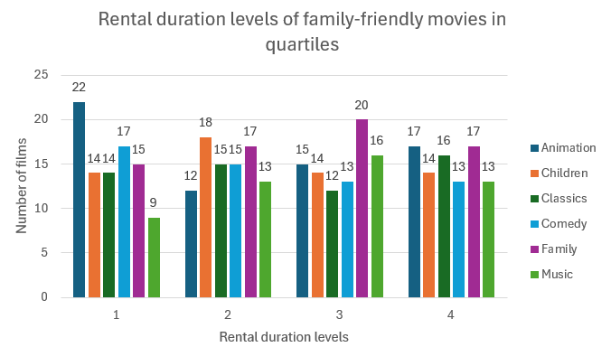
3. The number of family-friendly movies that have the same rental duration level and category?
At level 1, Animation is the most rented film category.
At level 2, Children is the most rented film category.
At level 3, Family is the most rented film category.
At level 4, Animation and Family are the most rented film category.

Slide 4
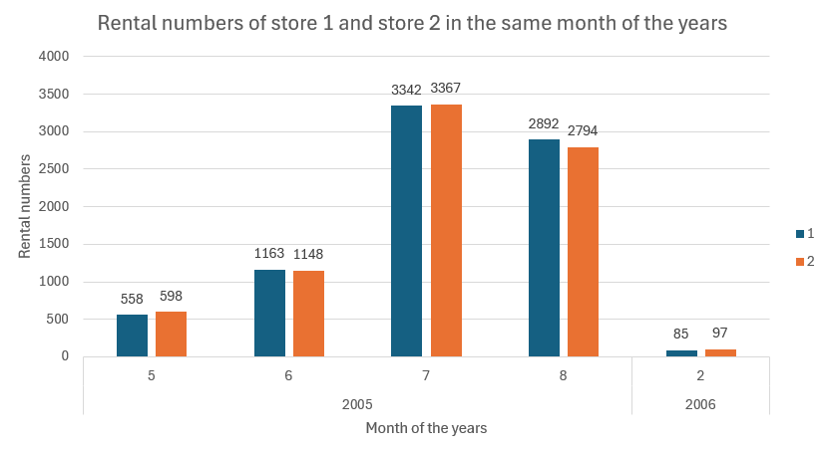
4. Compare the rental numbers of any two stores in the same month of the years?
Store 1 and store 2 have not much difference in rental numbers in the same month of the years

